Slide 1
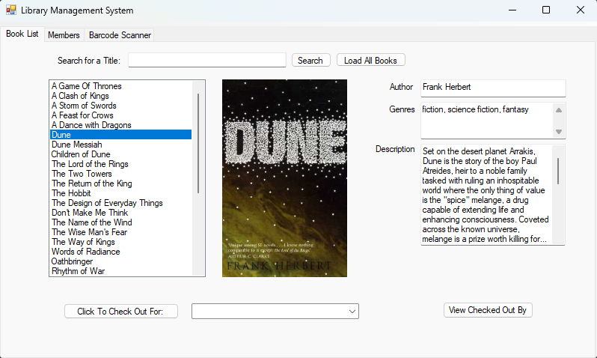
Library Management System
Jamie Groves
Corea Kittii
George Obianwu
Remon Shenouda
Dominic Swader

Slide 2
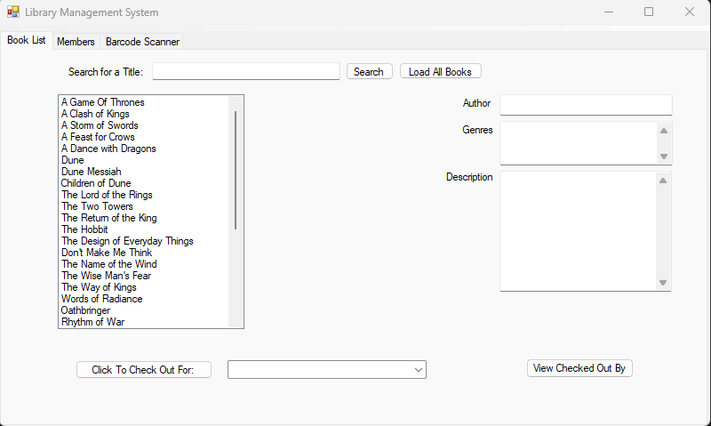
Book List
Created a listbox to pull the titles of the books from the database
Based on the title, all other information is filled out via OpenLibrary API
Added a feature to allow to search for a book based off the title
Allow you to select a user via the drop down and check out a book for them
Added a feature to query the database to find out who has a certain book checked out
JG

Slide 3
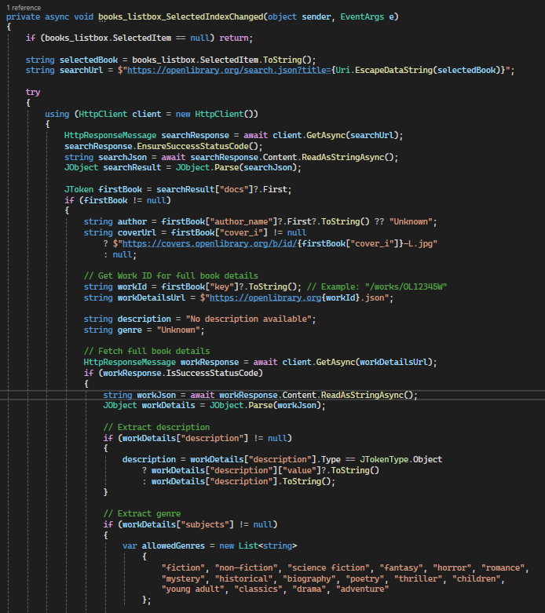
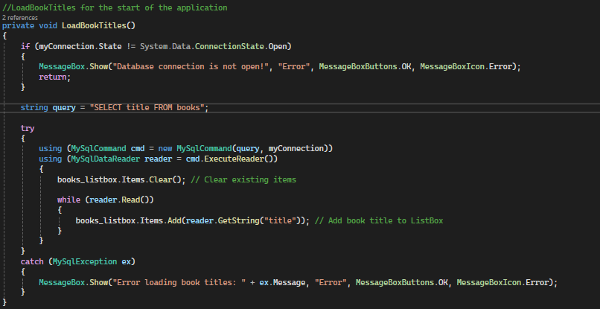
Books Tab Code
JG

Slide 4
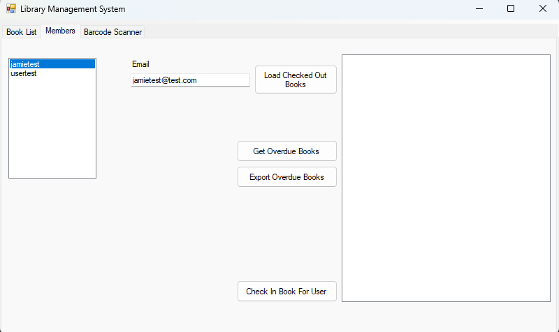
Members Tab
Configured the Members Tab
Created a listbox for the members and for the books checked out
Overdue books are based on a two week time period
Export overdue books will pull up a save dialogue and allow you to save the exported over due books
JG

Slide 5
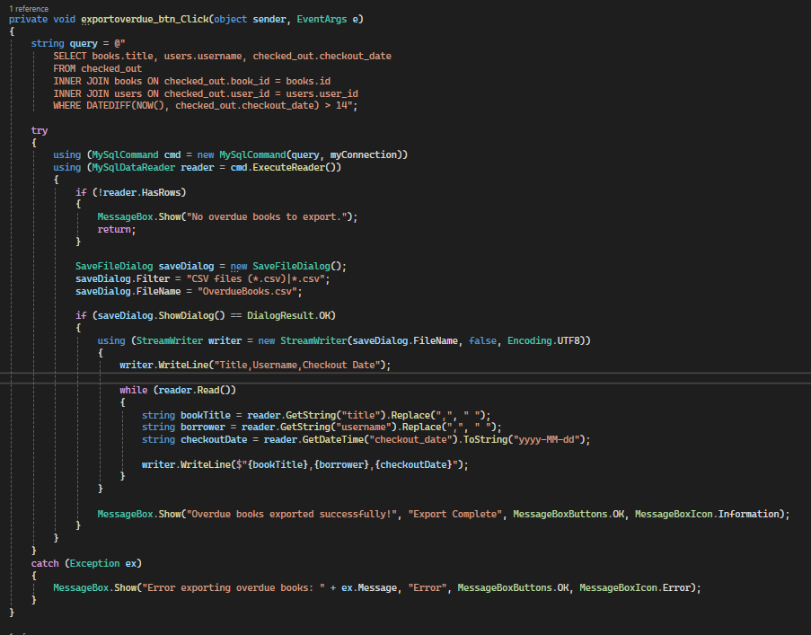
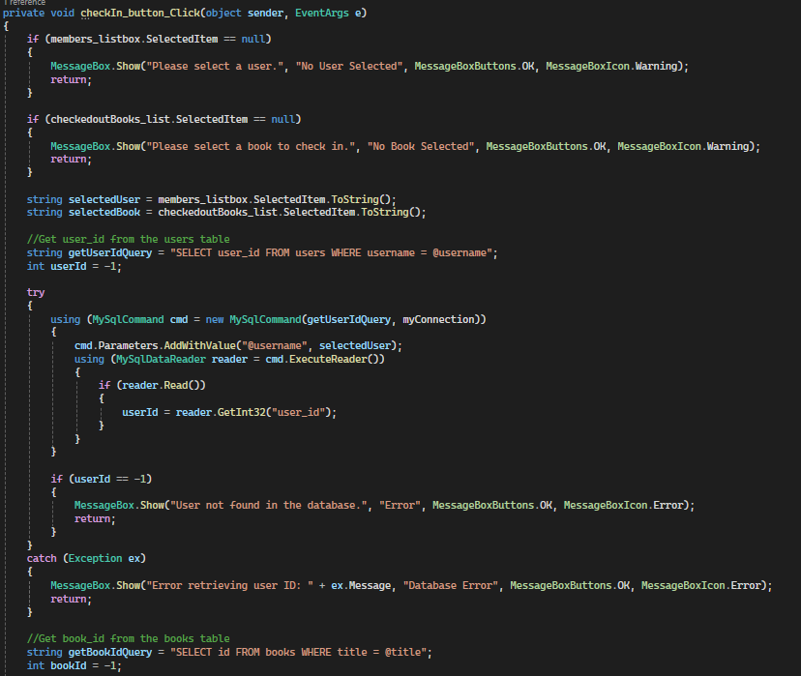
Members Tab Code
JG

Slide 6
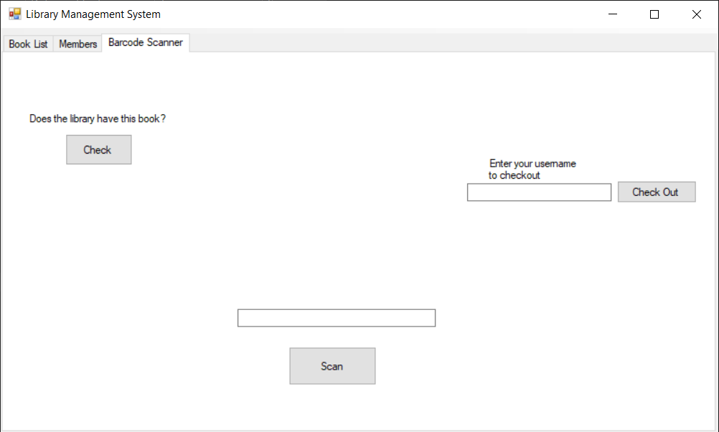
Barcode Scanner Tab
Reads an ISBN-13 barcode from an image file
Searches for the book via the OpenLibrary API
Pulls book info from the API if it exists
Allows the user to check if the book exists in the local database
If the book exists, allows the user to checkout that book
CK

Slide 7
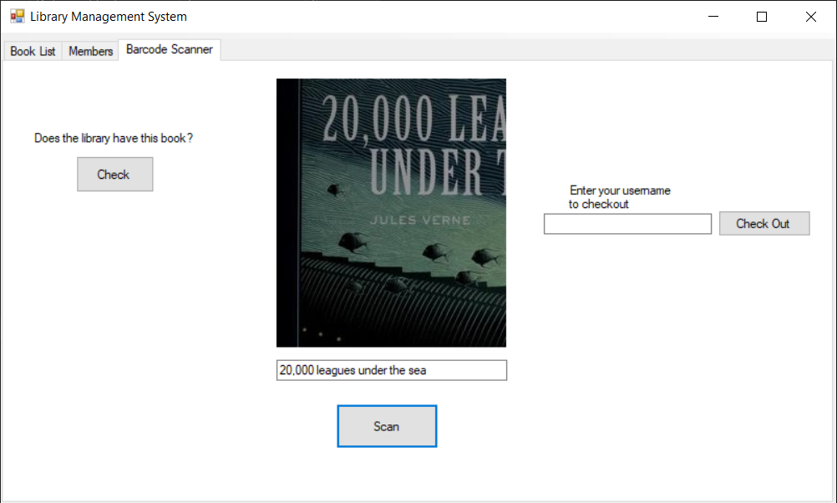
Barcode Scanner Tab
Reads an ISBN-13 barcode from an image file
Searches for the book via the OpenLibrary API
Pulls book info from the API if it exists
Allows the user to check if the book exists in the local database
If the book exists, allows the user to checkout that book
CK

Slide 8
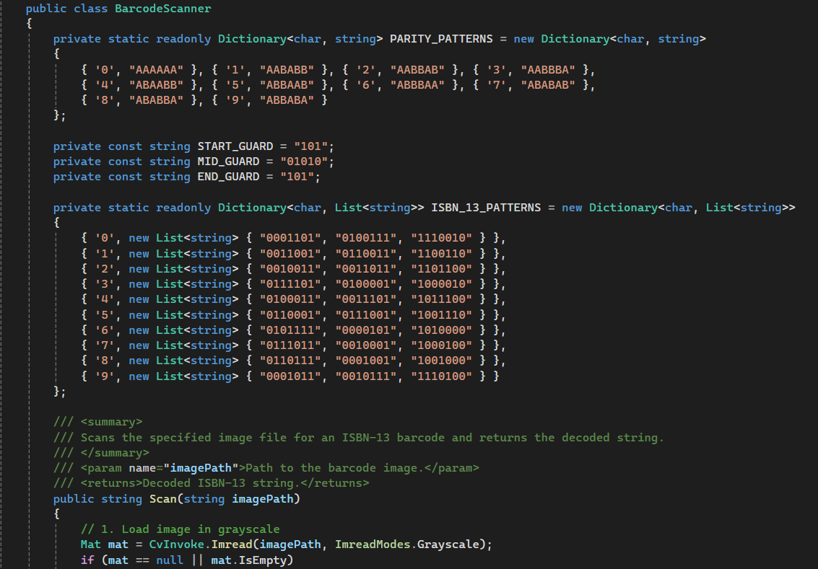
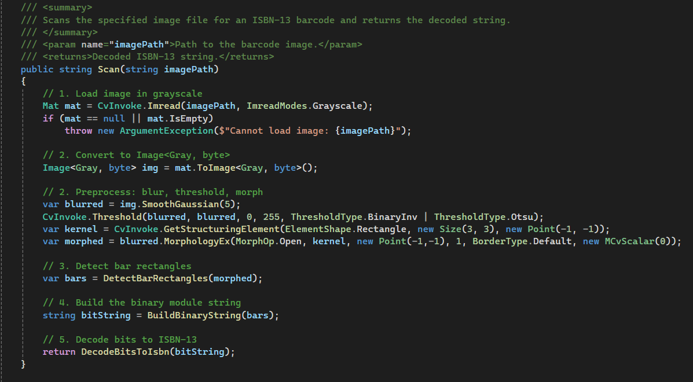
Barcode Scanner Code
CK

Slide 9
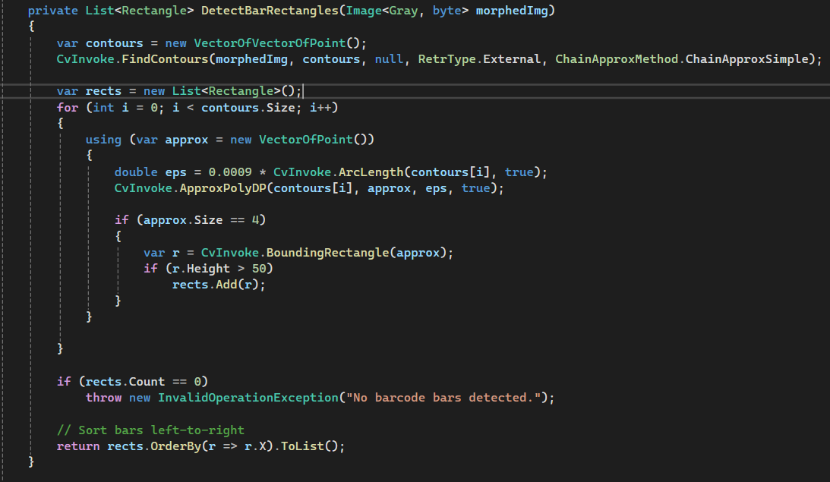
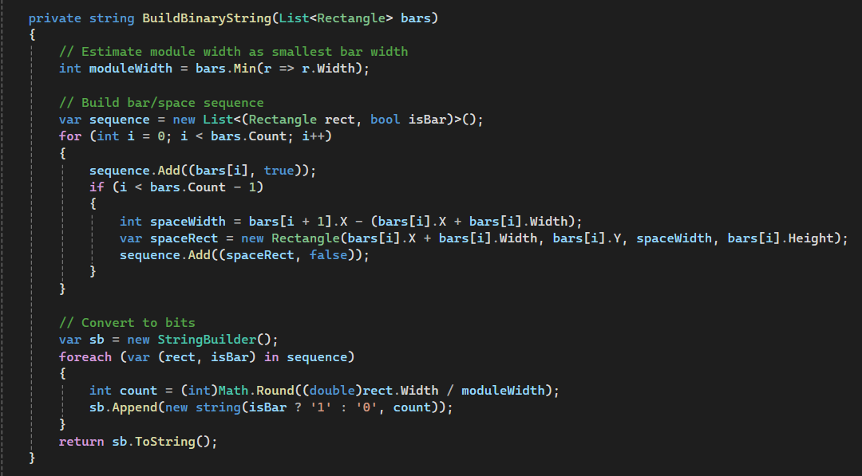
Barcode Scanner Code
CK

Slide 10
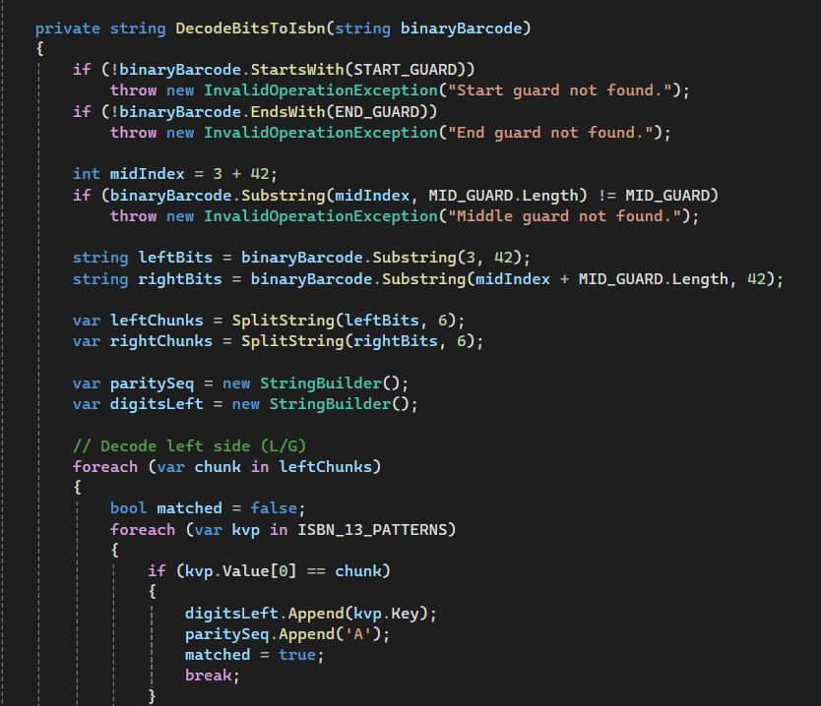
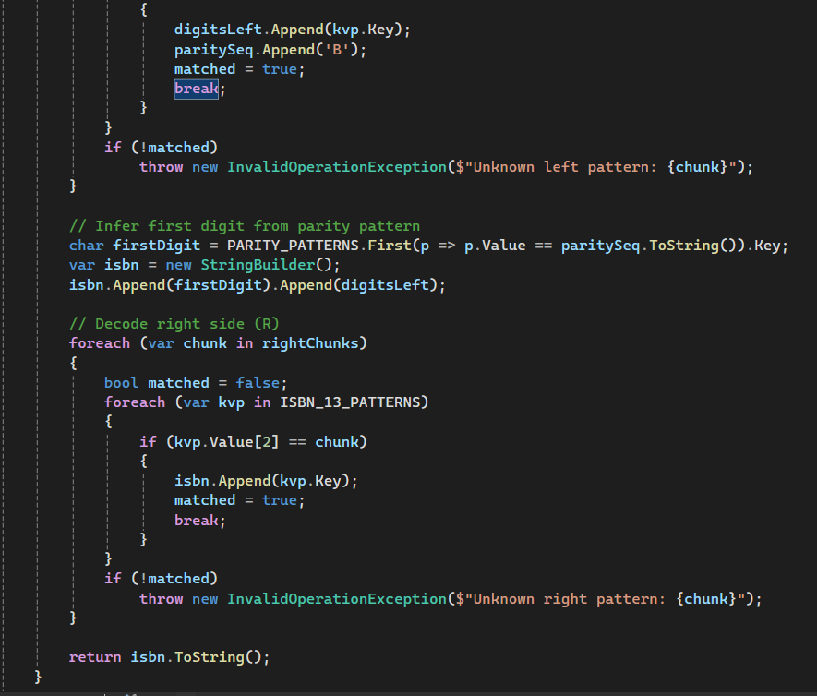
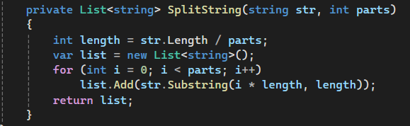
Barcode Scanner Code
CK

